Slide 1
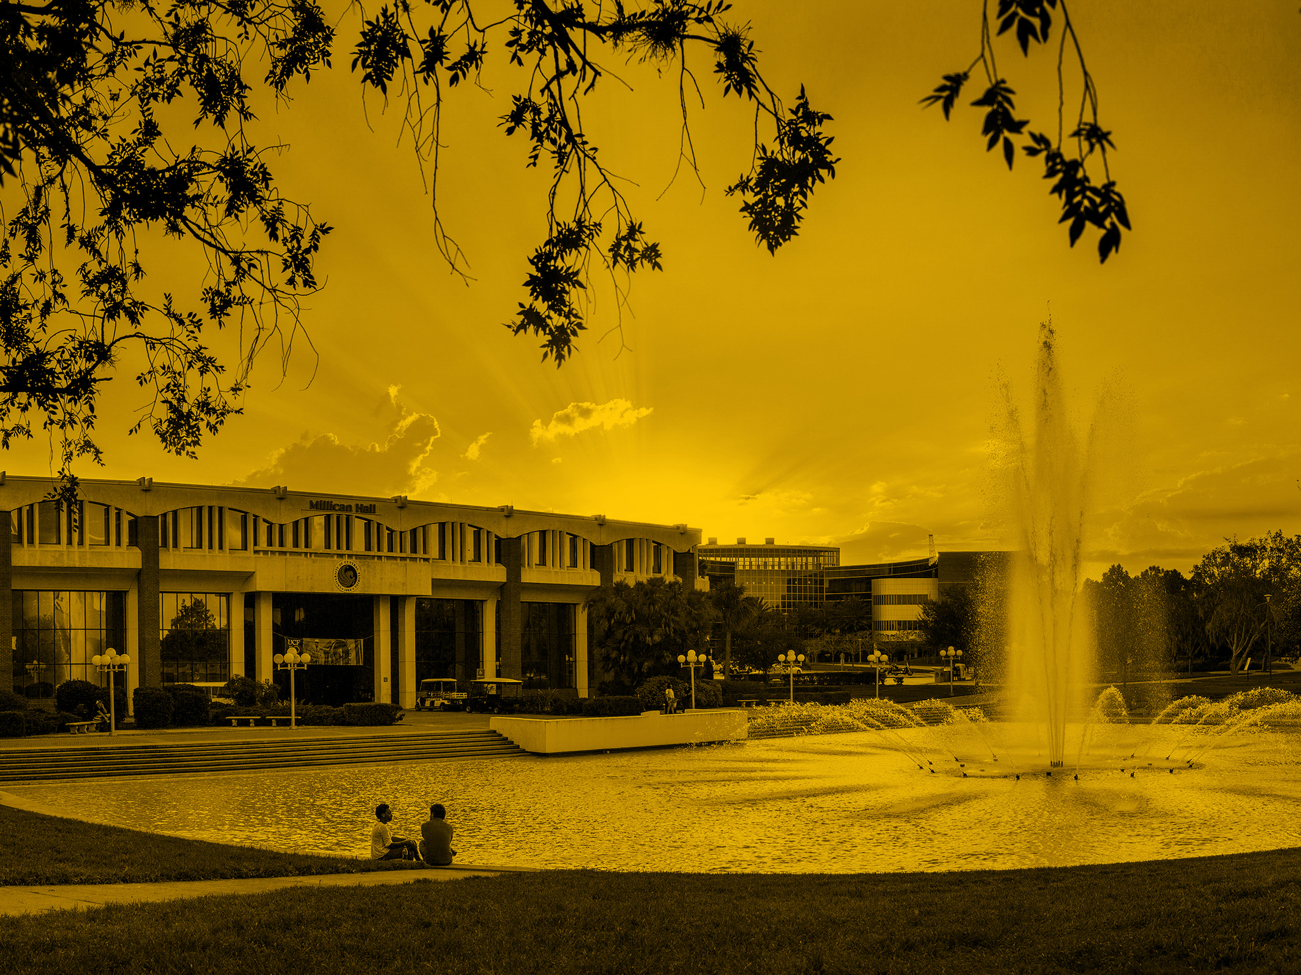
Using Virtual Reality in CBE Program Design
Accessibility, Inclusion and UDL walk into a restaurant…
Tina Calandrino, Instructional Designer
University of Central Florida

Slide 2
SESSION OBJECTIVES
Explain the importance and benefits of web accessibility for people with disabilities and older people
List common barriers experienced by people with disabilities and older people
Understand that UDL Guidelines are the international standard for web accessibility Abstract

Slide 3
What are we really talking about?
Undisclosed disabilities
Known disabilities (what are some common ones?
Second language issues
Older adults (over 40)
Almost 30% of online higher ed students (According to Dept of Ed Fast Facts Website
https://nces.ed.gov/fastfacts/display.asp?id=64)

Slide 4
What if it was you?

Slide 5
The Basics
Use clear consistent headings
Limit navigation links and menu buttons
Provide instructions for course tools
Design with color contrast for text and background
Use san serif fonts or fonts designed for the Web (e.g., Verdana)
Insert alt tags for images

Slide 6
The Basics Continue
Use short sentences
Remember to Spellcheck
Write out acronyms
Use numbers rather than bullets
Provide an overview, subheadings, and summary
Keep tables simple with clear column and row headings

Slide 7
The Basics Part III
Create PDFs with Optical Character Recognition rather than as scanned images
Avoid cutting and pasting text from Microsoft Word – use Notepad to avoid extra code
Use Section 508 guidelines and Checklist
Be stingy with complex interactions
Use simple navigation
Talk to the Students!

Slide 8
Functionality via the keyboard
Meeting this requirement helps keyboard users, including people using alternative keyboards such as keyboards with ergonomic layouts, on-screen keyboards, or switch devices
All functionality that is available by mouse is also available by keyboard;
Keyboard focus does not get trapped in any part of the content;
Web browsers, authoring tools, and other tools provide keyboard support.

Slide 9
Content is easier to see & hear
Color is not used as the only way of conveying information or identifying content;
Default foreground and background color combinations provide sufficient contrast;
Text is resizable up to 200% without losing information, using a standard browser;
Images of text are resizable, replaced with actual text, or avoided where possible;
Users can pause, stop, or adjust the volume of audio that is played on a website;
Background audio is low or can be turned off, to avoid interference or distraction.

Slide 10
Text alternatives for non-text content
Text alternatives convey the purpose of an image or function to provide an equivalent user experience. For instance, an appropriate text alternative for a search button would be "search" rather than "magnifying lens".
Short equivalents for images, including icons, buttons, and graphics;
Description of data represented on charts, diagrams, and illustrations;
Brief descriptions of non-text content such as audio and video files;
Labels for form controls, input, and other user interface components.

Slide 11
Text alternatives for non-text content
Text alternatives convey the purpose of an image or function to provide an equivalent user experience. For instance, an appropriate text alternative for a search button would be "search" rather than "magnifying lens".
Text alternatives serve as labels for more than pictures: controls and functionality including web
Short equivalents for images, including icons, buttons, and graphics;
Description of data represented on charts, diagrams, and illustrations;
Brief descriptions of non-text content such as audio and video files;
Labels for form controls, input, and other user interface components.

Slide 12
Users have enough time
For instance, some people require more time to type text, understand instructions, operate controls, or to otherwise complete tasks on a website.
Stop, extend, or adjust time limits, except where necessary;
Pause, stop, or hide moving, blinking, or scrolling content;
Postpone or suppress interruptions, except where necessary;
Re-authenticate when a session expires without losing data.

Slide 13
Content does not cause seizures
Content that flashes at certain rates or patterns can cause photosensitive reactions, including seizures. Flashing content is ideally avoided entirely or only used in a way that does not cause known risks.

Slide 14
Content appears and operates in predictable ways
Navigation mechanisms that are repeated on multiple pages appear in the same place each time;
User interface components that are repeated on web pages have the same labels each time;
Significant changes on a web page do not happen without the consent of the user.

Slide 15
Content is compatible with current and future user tools

Slide 16
Go forth and be inclusive! Tina.Calandrino@ucf.edu Facebook: TOPkit Twitter: @TOPkitlive

